Slide 1


Module 4 – Curating Data Assets

Slide 2
Purview allows organizations to maintain centralized oversight power while empowering local teams to manage their data according to specific needs. This model supports data democratization and responsible data value creation.
Notes:
Traditionally, data governance curation was the responsibility of a central team, working down from the enterprise data model down, with the goal of representing the complete view of the organization’s processes and functions. This approach was slow, expensive, struggled to scale, and often didn't delivery the expected value. Microsoft's guidance is alter the approach, aligning to a federated governance model, and empowering the business to take ownership of their data.
A Federated data governance approach spreads ownership across your business, reducing bottlenecks and encouraging participation in the life cycle of managing, governing, consuming, and applying data. It brings the business along on the journey, and empowers data experts to have ownership and responsibility for the data they know best.
So given this, Data curation and federated governance are interconnected concepts, especially in the context of managing and utilizing data across diverse and distributed environments.

Slide 3
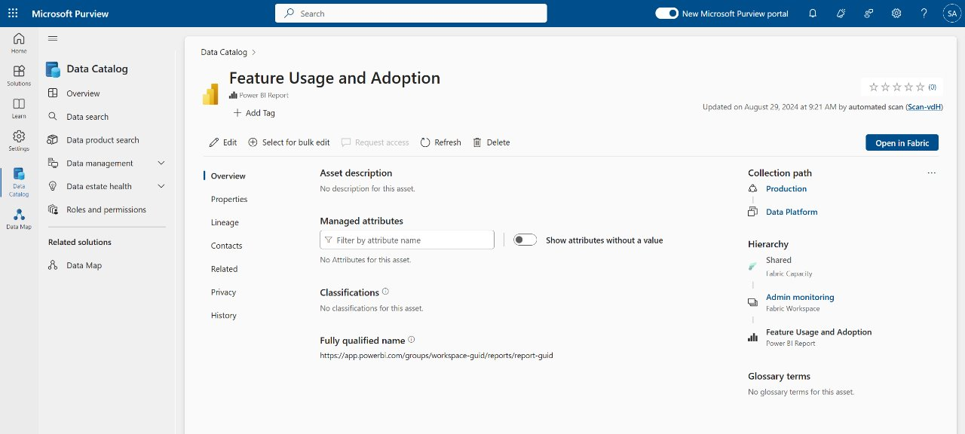
Federated Data Curation
Enriching the data for presentation by adding metadata, such as descriptions, tags, classifications, lineage information, contacts, etc.
Example of an Uncurated Data Asset
3
Notes:
Data curation is the process of organizing and managing data assets to ensure their quality, accuracy, and reliability.
Metadata curation is a central aspect of asset curation in Microsoft Purview. It involves updating and managing the metadata associated with data assets. This includes:
Technical Metadata: Automatically generated metadata such as name, schema, and source information.
Descriptive Metadata: User-added information like descriptions, contacts, and glossary terms, tags, classifications, lineage information, etc. to make them more discoverable and usable by end users.
Note how difficult it is to understand the purpose of the asset or what it represents - because it has not been described, tagged, or classified. This is a common problem in many organizations, and highlights why data curation is so important.

Slide 4
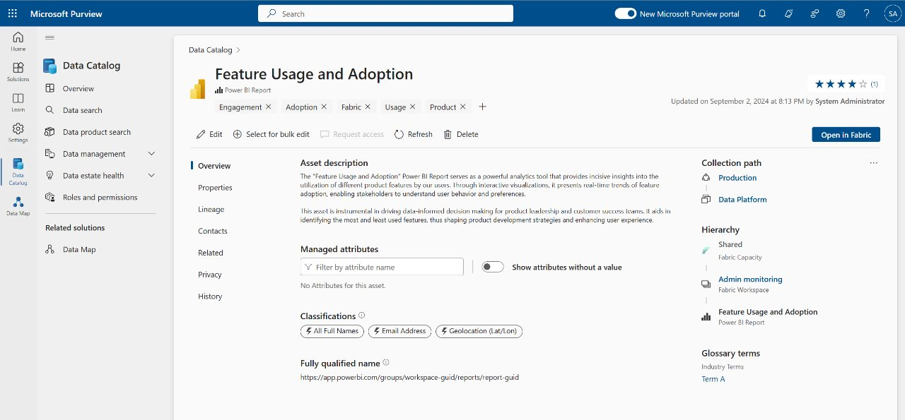
Federated Data Curation
Enriching the data for presentation by adding metadata, such as descriptions, tags, classifications, lineage information, contacts, etc.
Example of a Curated Data Asset
4

Slide 5
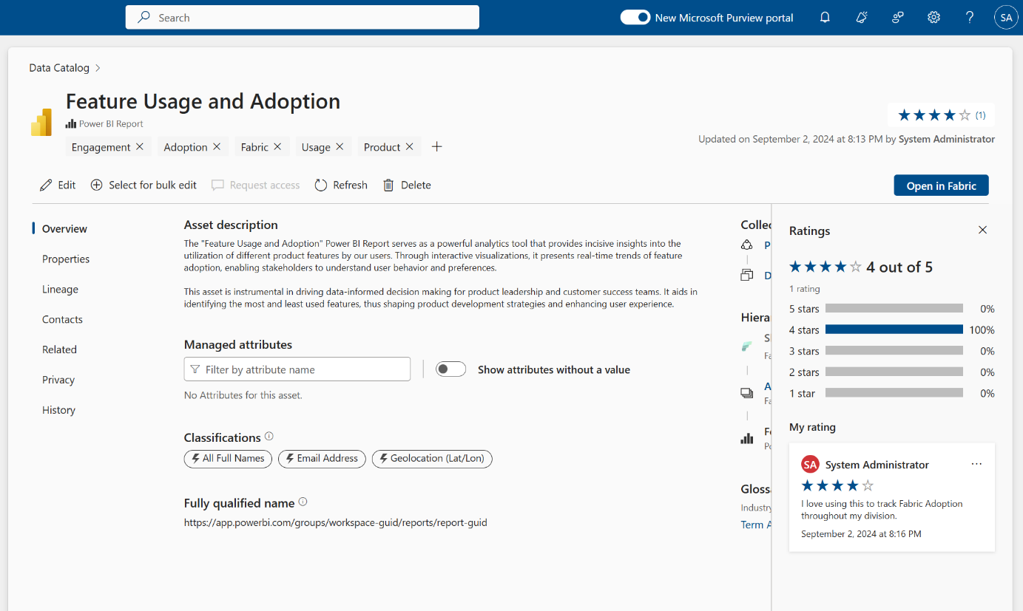
Collection-level role curation
Data curators can update these aspects of a data asset:
Display name
Description
Classifications
Column names
Column descriptions
Column classifications
Glossary Terms
Contacts
5
Notes:
Display name
Description
Contacts
Column descriptions
Column names
Column data types
Source classifications
Column classifications
Attaching glossary terms

Slide 6

Things to consider when curating data assets:
Is the name of the asset meaningful to business users?
Is the correct language and taxonomy used?
Can you add a rich text description to inform business users about the data asset and its potential use cases?
Should the asset be certified, and thus considered reliable for use throughout the organization?
Is the schema appropriately described?
Are experts and owners assigned?
Do we need to add any relevant tags to the asset to assist in its discovery?
Notes:
Exercise: Curating Data Assets
✍️ Do in Purview: [15 minutes] Navigate to a data asset in the catalog (via search / filters) to expand its data asset overview page. Spend a minute to familiarize yourself with the page and, as a team, begin to 'Edit' (curate) the asset.
Is the name of the asset meaningful to business users?
Is the correct language and taxonomy used?
Can you add a rich text description to inform business users about the data asset and its potential use cases?
Should the asset be certified, and thus considered reliable for use throughout the organization?
Is the schema appropriately described?
Are experts and owners assigned?
Do we need to add any relevant tags to the asset to assist in its discovery?

Slide 7
Module - 4
Lab Time

